Slide 1
Exploring NYC Neighborhoods for a Dog Friendly Restaurant

Slide 2
Introduction
I set out to find which neighborhood in NYC would be best to open a dog friendly restaurant.
Using Foursquare location data to retrieve a list of dog parks in NYC by searching “dog park” as a venue within a certain mileage.
Using Rent Café to find the average rent in each neighborhood in Manhattan

Slide 3
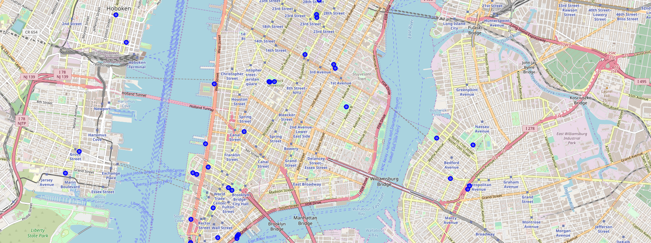
Map of Dog Parks NYC

Slide 4
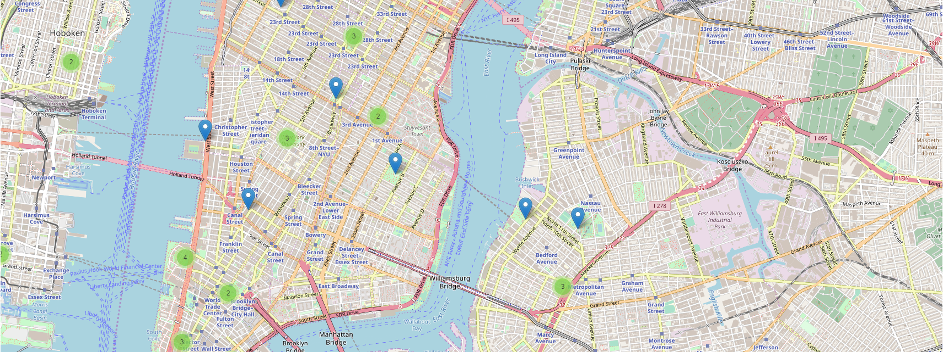
Cluster Map of Dog Parks NYC

Slide 5
Dog Park Ratings
Union Square Park was rated the highest at a 9.7.
While almost every park that had a rating over 8, the following parks had a rating of 9 or above: Tompkins, Washington Square Park, City Hall Park, Bryant Park Madison Square Park, Pier 25.
Several parks did not return ratings and East River Esplanade had the lowest rating at 6.4.

Slide 6
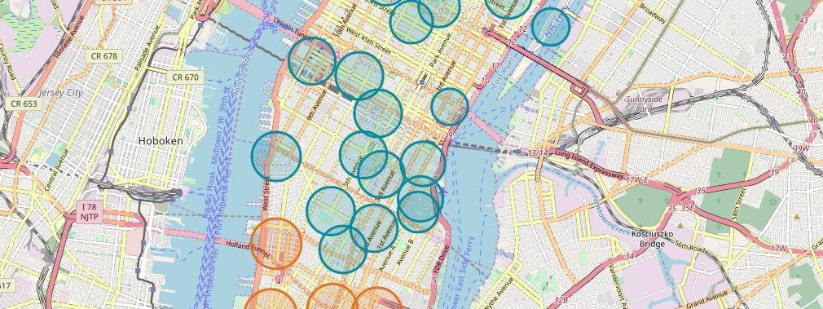
Average Rent Prices NYC

Slide 7
Results
The Foursquare search retrieved 50 dog parks in the specified radius surrounding NYC. The greatest number of dog parks are located downtown, close to the water. After this, there are several near NYU, Stuyvesant Town, and Flatiron.
After looking into rent prices, the map showed a general trend of higher average prices downtown and on the upper west side, as shown by the orange circle markers. While the Foursquare results showed the highest number of dog parks downtown, a money conscious entrepreneur on a budget may look to open their business above Houston and below Central Park.

Slide 8
Discussion
If someone looking purely at the count of dog parks in an area, downtown would be the place to open a dog friendly business.
If someone were looking to open their business near the highest rated dog parks, they may look around one of the parks listed above in slid 5.
While the Foursquare results showed the highest number of dog parks downtown, a money conscious entrepreneur on a budget may look to open their business above Houston and below Central Park.

Slide 9
Conclusion
The Foursquare data was helpful to find information on where dog parks are located, and most highly rated though there were some limitations to the analysis.
The NYC rent information was a good place to start a neighborhood search for a business location but would require further analysis.
Additional research would include:
How many ratings were included
Look into the locations of registered dogs
Available spaces to rent and actual price figures

